Slide 1
Gaian Asset Training Day
David Vyvyan, Paul Stone, Patrick Dantressangle
IBM Confidential

Slide 2
Contents
Gaian Install + sanity tests
Recap on GaianDB V1.5
Overview of Basic Gaian Features in V1.5 (separate slide deck)
Gaian Asset build and test framework: #Tests written, #Bugs solved
New Asset features in Gaian V2.1
  GUI path visualisation
  Federation features (VTI development features)
  Workload Management (Query monitoring, cancellation, timeout)
  Security (Policy extensions)
  Embeddability (In-process start-task/end-task)
  Distributed Processing (+How to implement Map/Reduce)
Supported features for MIPS (separate slide deck)
  Running Gaian as a Windows Service
  MongoDB and AccumuloVTI data source wrappers
“In-development” features
Notes:
“In Development” features include WebservicesVTI, Webserver, Gaian Lite?

Slide 3
Recap on GaianDB V1.5
This was the last Research version, publically available on IBM developerWorks
https://www.ibm.com/developerworks/community/groups/service/html/communityview?communityUuid=f6ce657b-f385-43b2-8350-458e6e4a344f
Features overview:
  Federation of heterogeneous data-sources: RDBMS tables, CSV text files, Custom sources.
  Automatic inter-node discovery and network growth
  Query propagation, with provenance columns and ‘explain’ mode to report query path
  Network topology management
  Message Storer
  Dashboard GUI
Overview of Basic Gaian Features in V1.5 (separate slide deck…)

Slide 4
Gaian Asset build and test framework
Client and server side build capability, manual and scheduled
Release builds include Trimming (to remove unsupported features) and Obfuscation
~250 tests executed as part of every build
Code coverage reporting using ‘Cobertura’ – also included with every build
Long tests push memory limits of a Node by registering a maximum number of logical tables
~200 bugs fixed, improving functions such as:
  The included data-source wrappers such as GExcel for Excel spread sheets
  The processing of large JOINs and the disk caching of their inner tables
  The reloading of logical tables and their wrapping database VIEWs
  The policy plugin API framework
  The propagation of query meta-data (e.g. user credentials)
  The robustness of discovery and connection establishment, across all platforms
  The capability to service concurrent configuration updates
  The ability to distinguish hanging queries from long-running ones, and abandon them when appropriate
  The consistency, isolation and performance of configuration APIs used for managing logical tables and data sources
  The detection of a lost/hanging connection when a peer node’s host was abruptly terminated

Slide 5
New Asset features in Gaian V2.1
GUI: Visualisation of query path leading to endpoints of a chosen logical table
Federation:
  Custom data sources (VTIs) management: Auto-pooling, schema resolution, columns mapping
  Pluralized data sources
  Batch configurability
Workload management: Query monitoring, cancellation and timeout
Security: Policy framework extensions
Embeddability: API to embed Gaian as a 'task' of a wrapping process (workspace management, task stop/restart) - compatible with OSGi
Distributed processing: Propagation of CRUD operations or procedure calls to targeted Gaian nodes - enables map/reduce

Slide 6
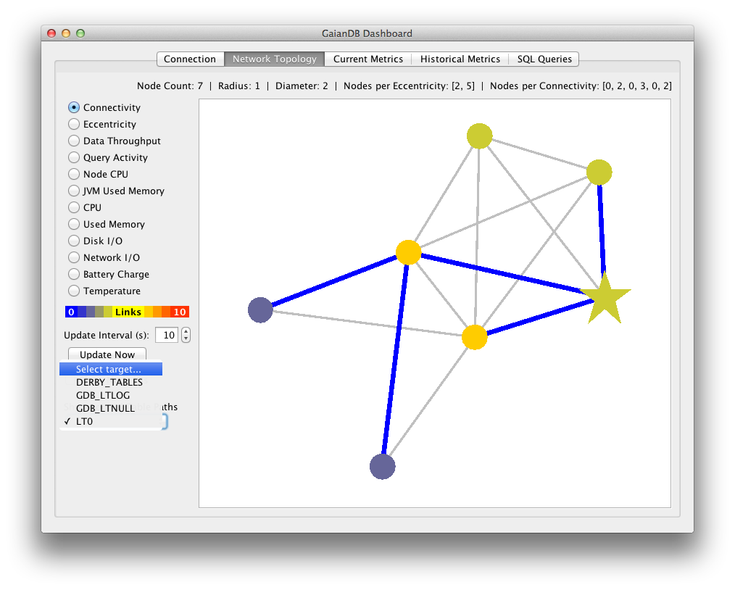
GUI path visualisation
Dashboard visualisation of query path leading to endpoints of a chosen logical table.
Drop-down list on the left shows the available logical tables on the entry-point node (marked as a star in the network).
Topology graph shows the path to other nodes in the Gaian network having a definition for the same logical table and at least 1 data source exposed through it.
This picture was taken after we removed the logical table on the top node.
The fastest path is shown, and may change for every new query.
Slower paths (also known as cross-talk) are not displayed. They are rejected straight away.

Slide 7
Federation – VTI pooling
Custom VTIs implemented as Gaian data source wrappers can now be ‘pooled’ by Gaian.
Pooling allows a VTI to be re-used, thus avoiding any setup processing and latency
Custom VTIs must override and implement the AbstractVTI.reinitialise() method.
This method should attempt to reset the state of the VTI so it is available for execute() again.
Gaian will pool the VTI for re-use if reinitialise() returns true

Slide 8
Federation – VTI schema resolution
Gaian now resolves the table shape (schema) of a custom VTI as follows:
First, the VTI may override the getMetaData() method itself, in which case that definition is used.
  This can be based on the data source wrapper’s _ARGS property which is passed in the VTI’s constructor
If the getMetaData() method is not overridden, Gaian will attempt to find a defined static property for the VTI having the "schema" suffix to resolve a schema, e.g. "<VTI_class_name>.schema”
If no static property is found, Gaian will attempt to find and use a data source wrapper schema property named: <LTNAME>_DS<DSNAME>_SCHEMA
As a final resort, Gaian will resolve the schema based on the logical table definition
If the VTI is invoked directly by Derby – i.e. referenced explicitly in SQL – the first 2 rules only will apply.
In all cases where the VTI is invoked as a Gaian data source, columns will be mapped by name to the logical table ones unless option MAP_COLUMNS_BY_POSITION is specified.

Slide 9
Federation – VTI columns mapping
Gaian now automatically manages any mappings that may be configured between a logical table’s columns IDs and the column names of a custom VTI.
This means that a custom VTI no longer needs to be aware of a logical table’s columns, and Gaian no longer passes it any column mapping information as before.
Sample logical table definition and data source wrapper properties:
  LTBIKES_DEF=ID INT, STATION VARCHAR(50), AREA VARCHAR(50), NUMBIKES INT, LAT DOUBLE, LONG DOUBLE
  LTBIKES_DSACC1_VTI=com.ibm.db2j.AccumuloVTI
  LTBIKES_DSACC1_ARGS=AccumuloUserInstance1, <MyAccumuloTable>
To simply map columns by position with the logical table ones, specify the corresponding option:
    LTBIKES_DSACC1_OPTIONS=MAP_COLUMNS_BY_POSITION
Alternate customised mapping, where ‘_Cn’ indices denote column positions in the logical table:
  LTBIKES_DSACC1_C2=STATIONNAME
  LTBIKES_DSACC1_C3=AREANAME
  LTBIKES_DSACC1_C4=NBBIKES

Slide 10
Federation – Pluralized data sources
These provide access to multiple end-points through a single Gaian data source definition:
  End-points are determined dynamically at runtime
  Currently available for structured text files (e.g. CSV) using wildcard or REGEX, and custom VTIs
  Custom VTIs implement ‘PluralizedVTI’ to provide their ‘Instance IDs’ and ‘Endpoint Constants’ for each ID. Gaian spawns a thread for each ID whose end-point constants satisfy the SQL predicate filters.
Example syntax for targeting multiple text files using the wildcard character (*):
  LT0_DS0_VTI=com.ibm.db2j.FileImport
  LT0_DS0_OPTIONS=INMEMORY,PLURALIZED
  LT0_DS0_ARGS=../*testfiles/datafile*.dat
  Example syntax to concurrently access multiple instances exposed by a VTI:
  LTX_DS0_VTI=myproject.MonitoredServers
  LTX_DS0_OPTIONS=PLURALIZED WITH ENDPOINT CONSTANTS C3 C4
  In this example, ‘MonitoredServers’ VTI accesses multiple servers as its end-points, and logical table column indexes 3 and 4 are Hostname and IP-Address columns which are both constants for each server.

Slide 11
Federation – Batch configurability
New API procedure ‘SETCONFIGPROPERTIES’ loads a set of properties into Gaian:
This vastly speeds up registration of logical tables and data sources (e.g. factor x30 for 700 logical tables) - More properties lead to greater gains
The API takes a SQL statement to target the Properties
Properties may be specified directly in the API, or selected from a Derby table
Example usage with explicit list of properties (String size is limited to 32762 characters)
  call setconfigproperties('SELECT * FROM (VALUES (‘’<Key1>'', ’’<Property1>''), ('’<Key2>'', ’’<Property2>''), ... , ('’<KeyN>'', ’’<PropertyN>'’))')
Example usage where table MY_PROPERTIES has 2 string columns ‘pkey’, ‘pval’:
  call setconfigproperties('SELECT pkey, pval FROM MY_PROPERTIES ORDER BY pkey')
The order of the properties is preserved when persisting them in gaiandb_config.properties

Slide 12
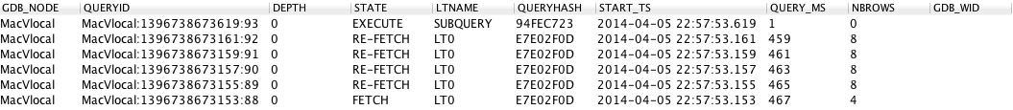
Workload management
Gaian now provides features for Query monitoring, cancellation and timeout.
Query monitoring is achieved using stored procedure ‘listqueries(<depth>)’, e.g:
  call listqueries(-1) – The integer argument limits the propagation depth of the procedure if positive
A slow query may be cancelled using stored procedure ‘cancelquery(<queryID>)’, e.g:
  call cancelquery(‘MacVlocal:1394970400271:0’)
Query timeout milliseconds can be specified using tag ‘GDB_TIMEOUT’ in the SQL comment, e.g:
  select * from BIG_LT1, BIG_LT2 – GDB_TIMEOUT=10000

Slide 13
Security
Gaian’s Policy API generic method ‘SQLResultFilterX.executeOperation()’ now provides client plugins with access to new information about a received SQL Query:
The Derby username for the local connection – allows integration with Derby security.
The Gaian Cluster IDs of the node where it was originally injected
  Cluster IDs restrict connectivity between nodes and can be used to assign conceptual roles to them.
The client plugin also has control to abort the query or let it continue by returning FALSE or TRUE.
This complements other methods providing similar control based on other query details:
Logical table name (as above, the plugin may abort the query based on this)
Full query path (same control)
Last forwarding node (superseded by full query path)
Custom credentials information – passed & retrieved via the SQL within the HINT fragment (same control)
Queried columns
Data sources linked to the logical table (the plugin can limit #rows extracted from them)
Extracted Records (the plugin can modify their cells)
The sister interface ‘SQLQueryFilter’ allows manipulation of the input SQL – This has not been changed since Gaian V1.5 (Research version).

Slide 14


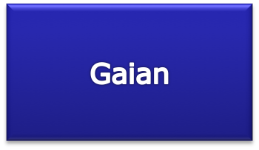

Security – Policy control
Query results
modified by Policy
SQL Query
Query
details
Columns to query + Predicates to apply
Other Gaian Nodes
Query details +
Retrieved records
Propagate
Query
Filtered records/cells
RDBMS
Flat Files
XLS Spread
sheets
Custom
Data Sources

Slide 15
Embeddability
Gaian has an improved API and workspace management allowing it to be embedded as a 'task' of a wrapping process
  Compatible with OSGi framework
Workspace folder can be separate from the install folder. It is now specified using Java system variable: ‘derby.system.home’ before GaianNode startup, and contains:
  Gaian and Derby configuration files
  Gaian and Derby log files
  Gaian’s Derby database
Usage of Public Methods API on the GaianNode class in GAIANDB.jar:
  'start()’ – starts the GaianNode threads, with optional GaianNode arguments. Java system property ‘derby.system.home’ should be set with the workspace location before calling this method.
  'isStarted()' – Returns true if GaianNode initialization is complete
  ’stop()’ – Stops GaianNode threads including Derby network server listening on the Gaian port.

Slide 16
Distributed processing + Map & Reduce
Gaian supports “push-through” propagation of CRUD SQL operations (INSERT, SELECT, UPDATE, DELETE) – as well as CREATE and procedure calls – to targeted Gaian nodes.
This capability is only partly implemented in Gaian 1.5
Capability to target specified nodes is achieved with predicates on provenance column GDB_NODE
‘Map & Reduce’ with propagated table functions:
Sub-query with ‘Map’ table function run against targeted nodes which all create sub-results
Sub-results from the worker nodes are returned to the master node which performs the ‘Reduce’
  ‘Map’ function could be recursively propagated out to more worker nodes if required
  See separate slide deck for more detail on how to implement Map/Reduce with Gaian: “Gaian Asset Training Day - V2 MAP_reduce.ppt”

Slide 17
Supported features for MIPS:
Separate slide deck: Gaian MIPS.ppt

Slide 18
“In Development” features
Generic access to web services using WebServicesVTI
Gaian Web Server
Discovery client ‘sprayer’ (coded as JDBC driver)
New deployment capability to IBM Bluemix cloud
UDP Driver for inter-node connectivity over UDP
'Lite' Driver to run independently from Derby (with limited SQL capability)
Running Gaian as a Windows Service
Extensions for MIPS project (not currently in the Asset):
  MongoDB VTI
  Accumulo VTI

Slide 19
Wrap-up / Questions…

